Slide 1

Identifying Threat Modeling Limitations

Slide 2
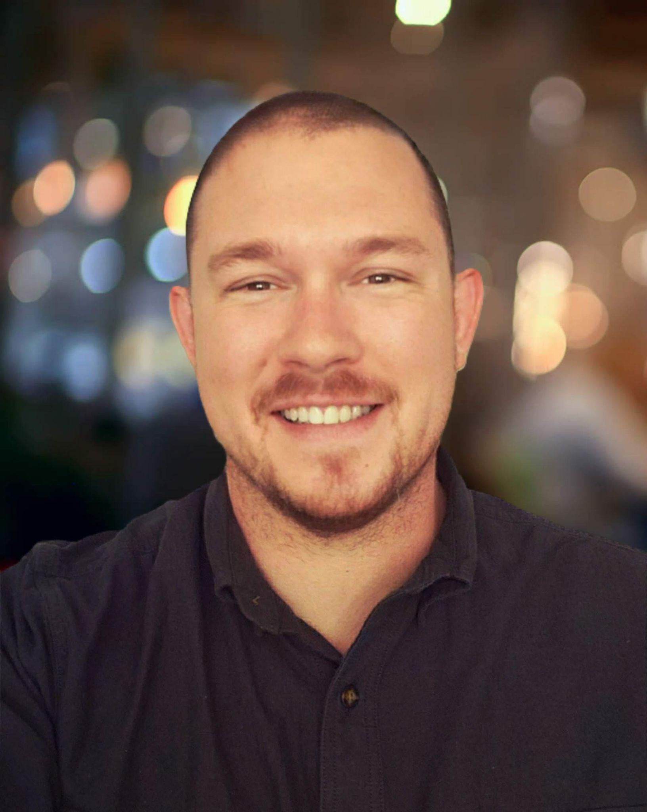
About me
Sr. Solutions Architect at IriusRisk
10 years in technology, security & compliance consulting
Husband & Father
Founding member at Threat Model Connect

Slide 3
AGENDA
Threat Modeling Value Chain Defined
Threat Modeling Limitations
Best Practices in Threat Modeling
The Future of Threat Modeling

Slide 4
Identifying the Threat Model Value Chain
Process Improvement/Tool sustainment/scale
1.
What are we building?
2.
What can go wrong?
3.
What are we going to do about it?
4.
Did we do a good job?
Deconstructing an application or Re/defining scope
Improvement & Reporting Requirements
Assessing Threats
Control Review

Slide 5
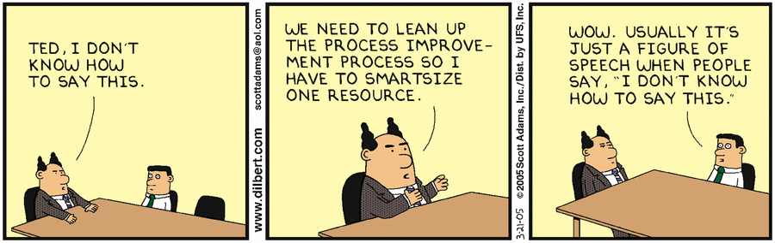
Threat Modeling Limitations
Good tools don’t fix bad process

Slide 6
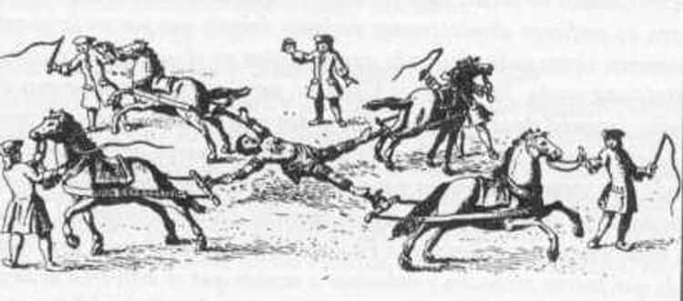
Threat Modeling Limitations
Good tools don’t fix bad process
People centered threat modeling
Notes:
Being drawn and quartered is a good visualization for the perils of building a threat modeling practice around one or two skilled individuals.

Slide 7
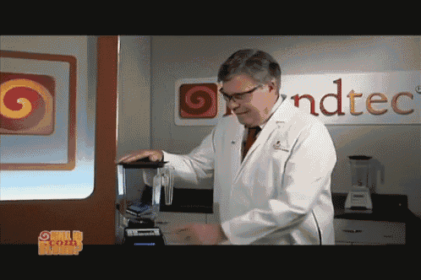
Threat Modeling Limitations
Good tools don’t fix bad process
People centered threat modeling
Non-scalable processes
Notes:
Will It Blend? is a viral marketing campaign consisting of a series of infomercials demonstrating the Blendtec line of blenders, particularly the Total Blender. In the show, Blendtec founder Tom Dickson attempts to blend unusual items to demonstrate the power of his blender.

Slide 8
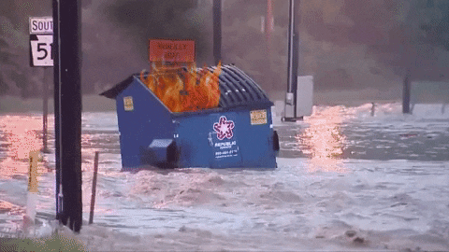
Threat Modeling Limitations
Good tools don’t fix bad process
People centered threat modeling
Non-scalable processes
GIGO

Slide 9
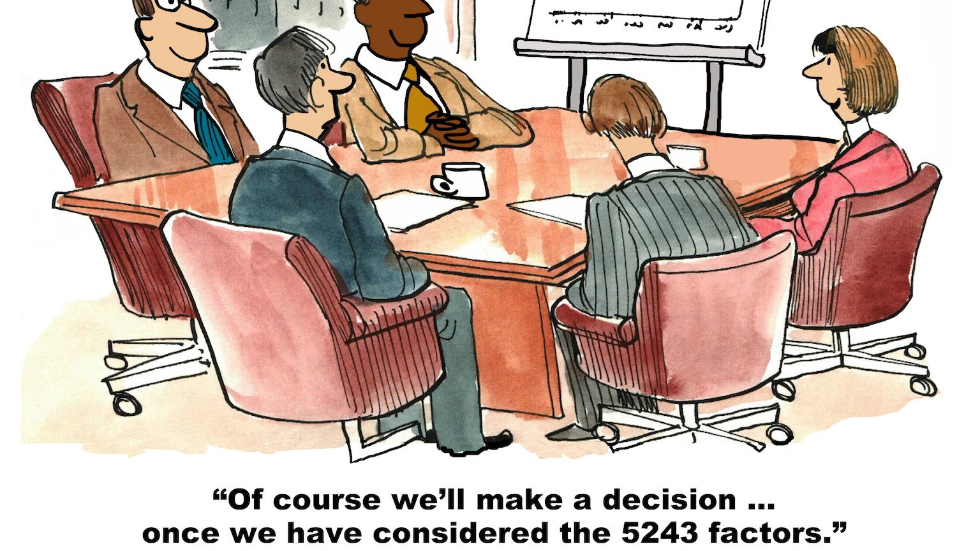
Threat Modeling Limitations
Good tools don’t fix bad process
People centered threat modeling
Non-scalable processes
GIGO
Analysis Paralysis

Slide 10
Best Practices in Threat Modeling
Process Focused (Defined, Measured, Analyzed, Improved, Sustained)
Value Aligned
Building better security champions (scale people and knowledge)
Flexible and Extensible Tools (scale and sustain process)
Judicious limit of scope while threat modeling
Iterate, iterate, iterate

Slide 11
The Future of Threat Modeling
UL/SL - Trends/Patterns
Improves new structure
SL - Data Sets - OWASP, MITRE, CVE, CVSS, CWE, OSINT…
1.
What are we building?
2.
What can go wrong?
3.
What are we going to do about it?
4.
Did we do a good job?
Inferred Deconstruction
Machine Learning
Improvement/Data Set Growth & Reporting Requirements
PCI, GDPR, CCPA, HIPAA, FEDRAMP
Notes:
Supervised Learning & Unsupervised Learning
Hey did you hear about this?
It seems like this priority is off? Would you like to re-evaluate?
Looks like you missed these items
Hey it seems like you seem to fix a lot of these kinds of items. Have you considered this practice? Here is education for your security champions.

Slide 12
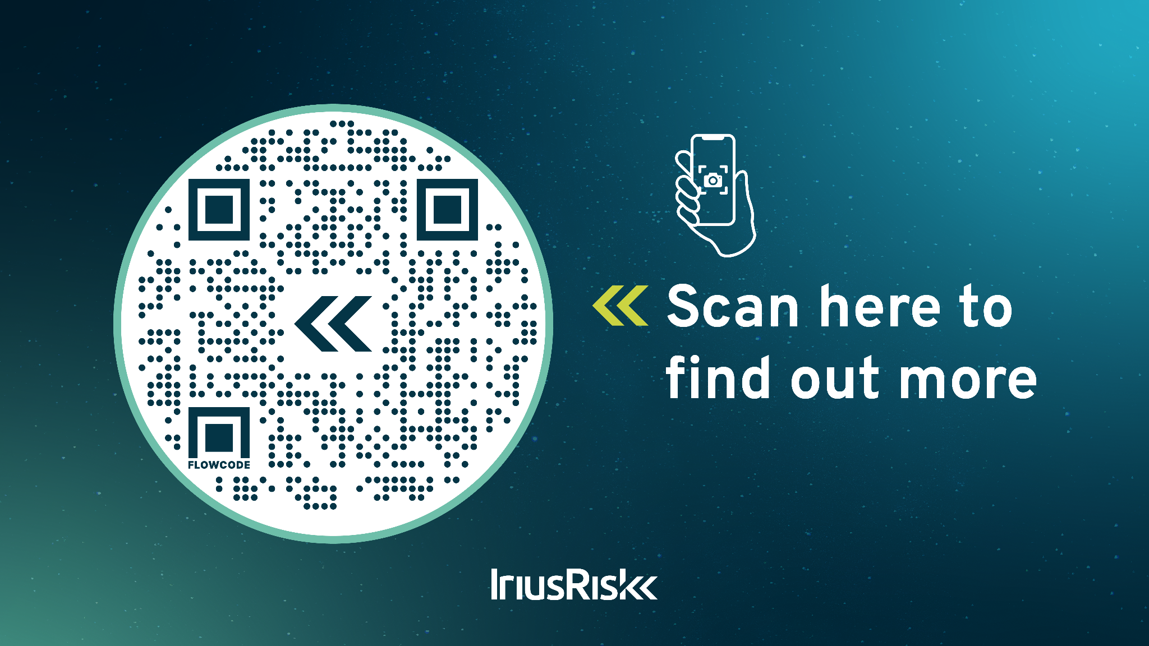
Notes:
IriusRisk would like to do a giveaway for those of your interested. We’re giving away $100 Amazon gift card. Please go to the link on the slide and complete the form to be entered into the drawing. One lucky winner will receive a gift card. There’s also additional resources on this web page to learn more about threat modeling and you can also sign up for our free Community Edition.

Slide 13



THE END
JRabe@IriusRisk.com
linkedin.com/in/jrabe3
ThreatModelingConnect.com

